Slide 1
CORRUGATED CARDBOARD
DEFINITION AND GENERAL CHARACTERISTICS

Slide 2
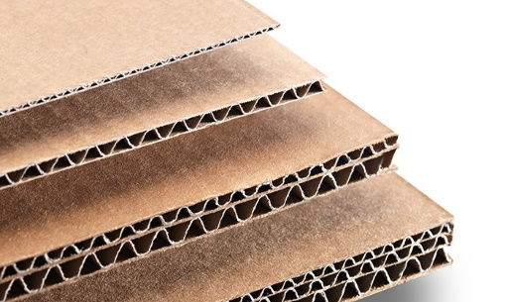
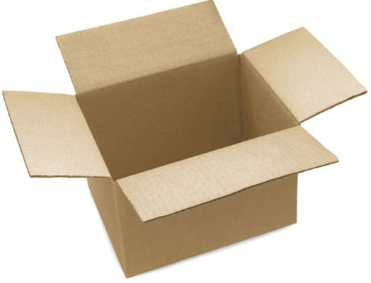
CORRUGATED CARDBOARD: DEFINITION
Lightweight structure, but with high strength obtained from the union of several sheets of paper by a starch-based glue.
THE RESULT IS A MATERIAL:
- ECONOMIC
- HIGH STRENGTH
- GOOD MECHANICAL PERFORMANCE
IT IS AN IDEAL RAW MATERIAL, TO ELABORATE:
LIGHT PACKAGING
ECONOMICAL
VERY RESISTANT

Slide 3
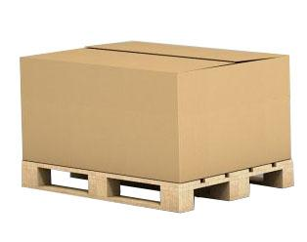
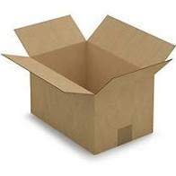
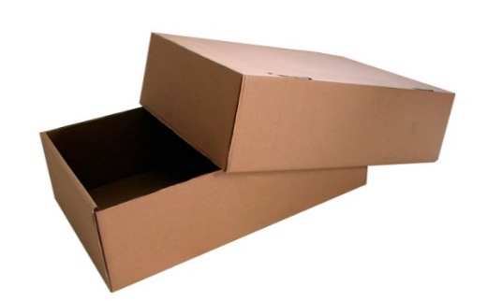
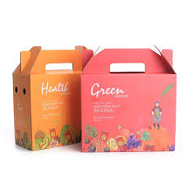
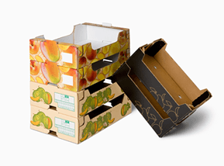
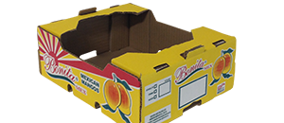
CORRUGATED CARDBOARD: APPLICATIONS-PACKAGING
With this structure, we can manufacture different types of boxes for all kinds of clients, with or without printing.

Slide 4
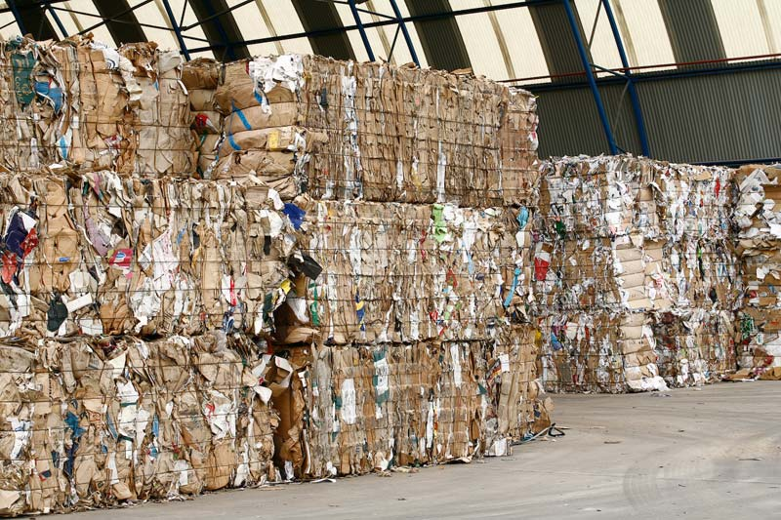
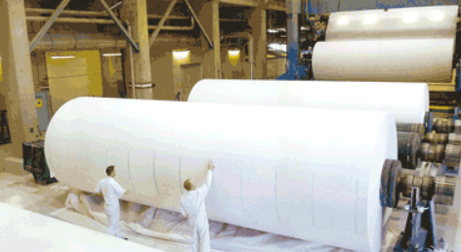
CORRUGATED CARDBOARD: RECYCLABILITY
It also has the advantage over other materials that it is recyclable and consequently less polluting.

Slide 5
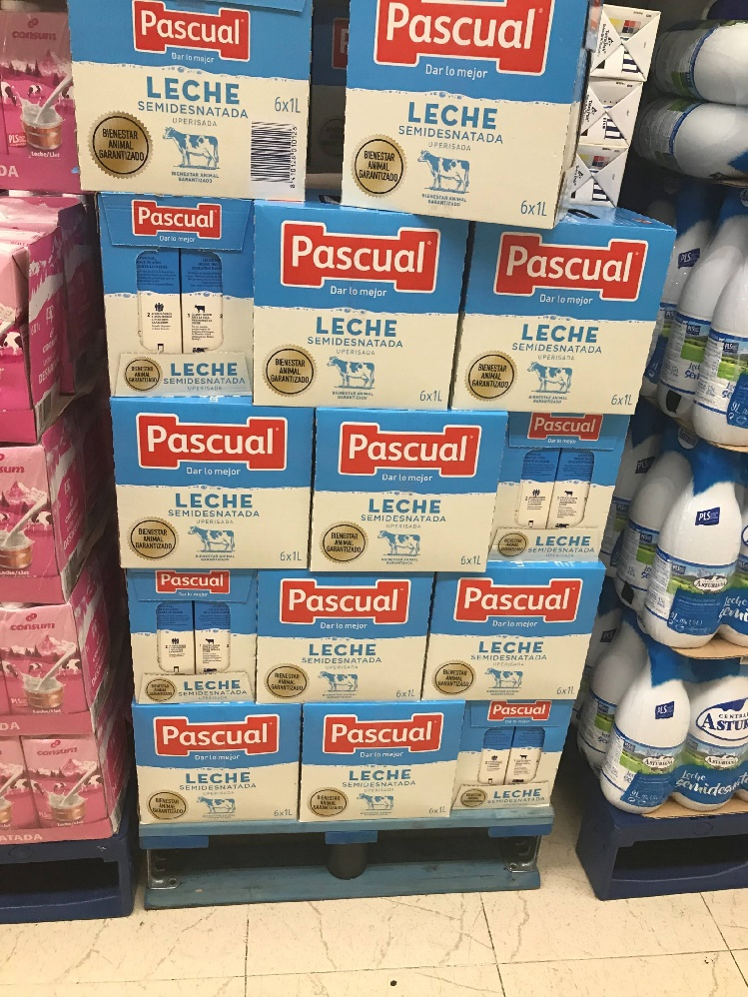
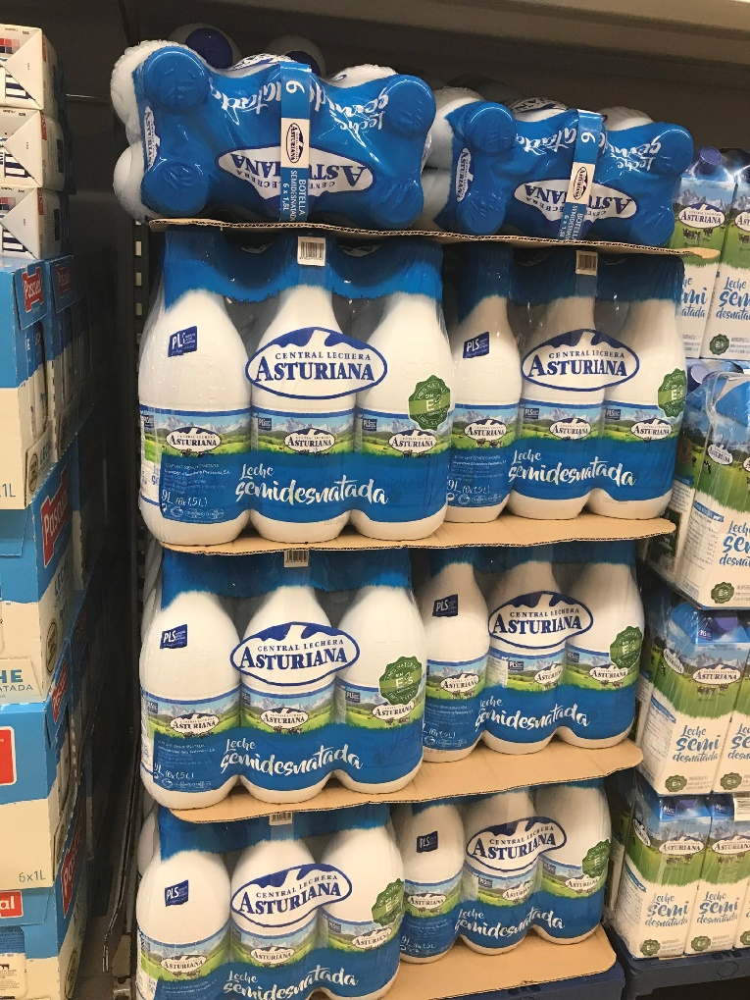
CORRUGATED CARDBOARD: RECYCLABILITY
Its recyclability makes it attractive, even compared to shrink wrap, which is cheaper and lighter than cardboard.

Slide 6
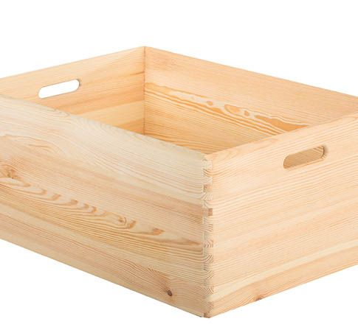
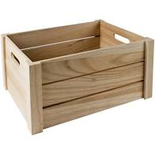
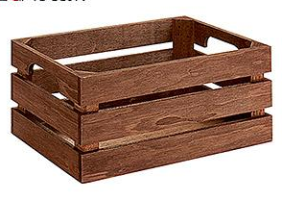
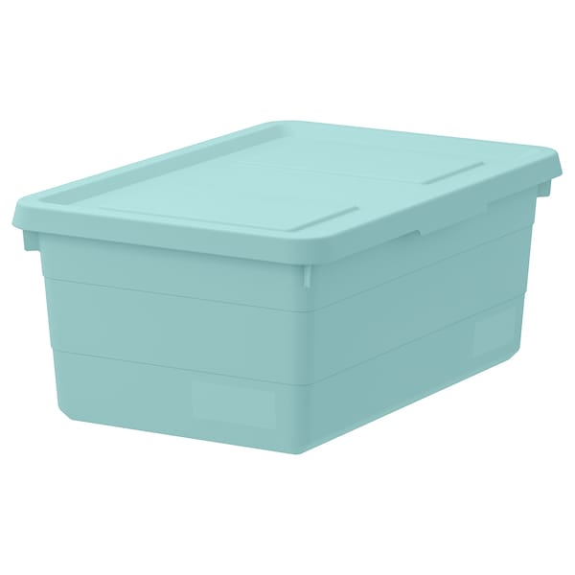
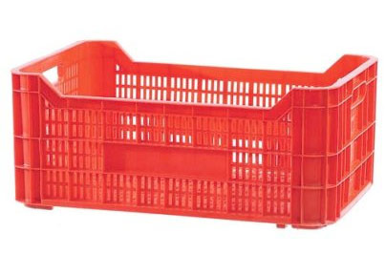
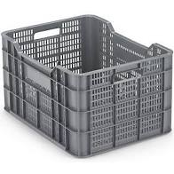
CORRUGATED CARDBOARD: COMPETITIVENESS
These qualities make it very competitive compared to other materials, especially wood and plastic.

Slide 7
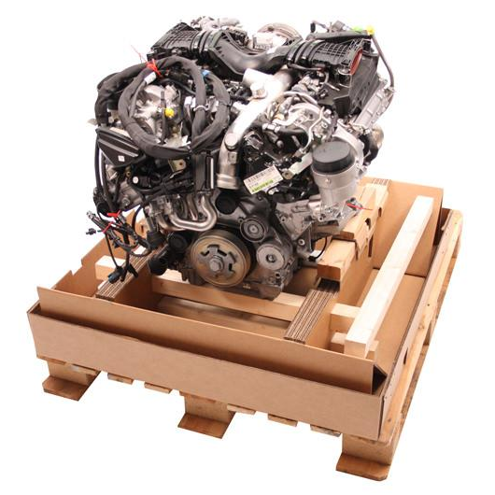
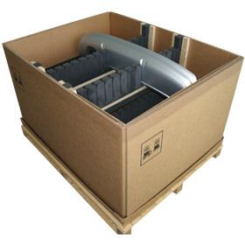
CORRUGATED CARDBOARD: VERSATILITY
It is also commonly used combined with other materials, in special and resistant packaging such as plastic or wood.

Slide 8
CARDBOARD: TYPES OF CORRUGATED CARDBOARD
EASY FACE
SIMPLE WAVE
DOUBLE WAVE
TRIPLE WAVE
QUADRUPLE WAVE

Slide 9
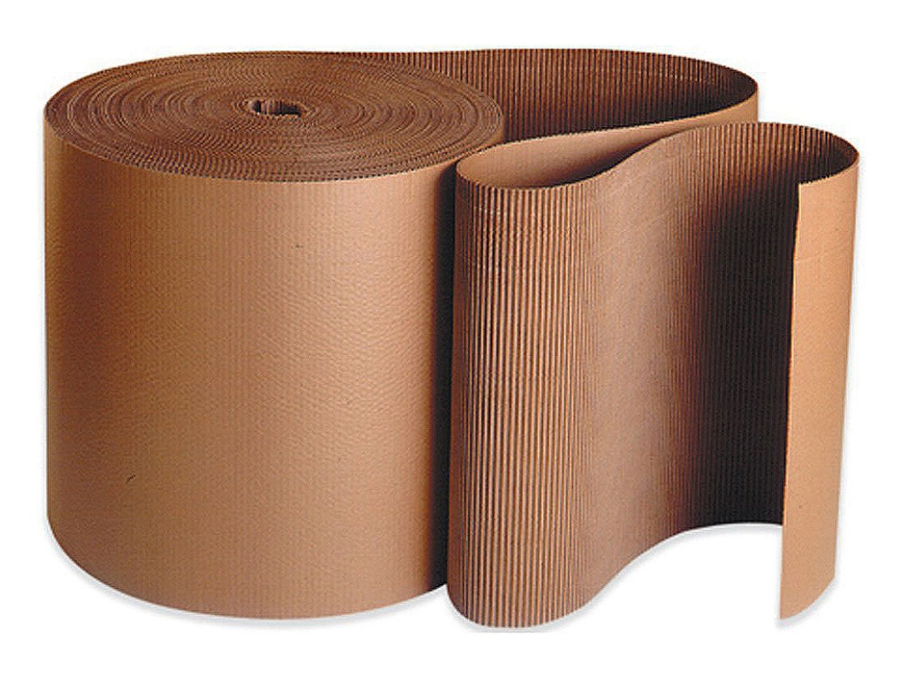
CARDBOARD: SINGLE FACE
Union of corrugated paper with smooth paper, usually sold in rolls or reams (pre-cut formats)

Slide 10
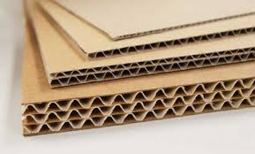
TYPES OF CARDBOARD
Different types of corrugated cardboard: E wave, C wave, BC, triple A.

Slide 11
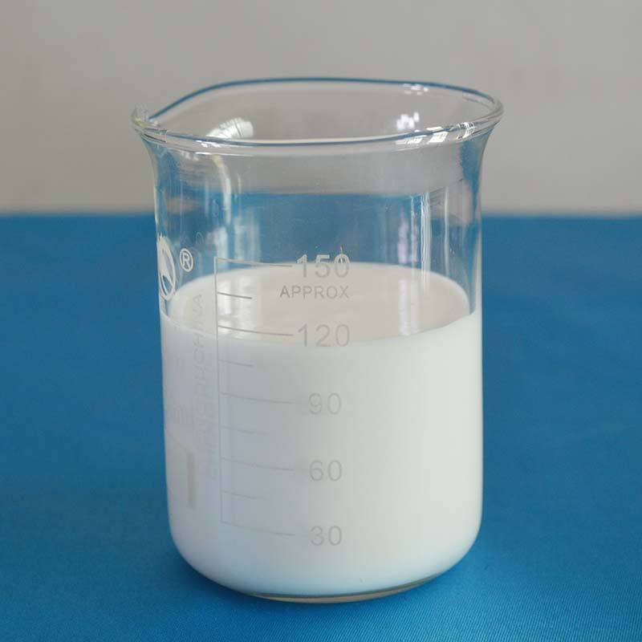
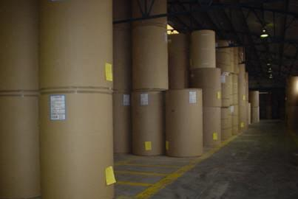
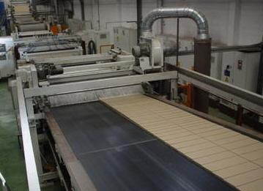
CARDBOARD: NECESSARY ELEMENTS FOR ITS MANUFACTURE
The fundamental elements involved in the manufacture of corrugated cardboard:
STARCH TAIL
PAPER
Faces - liners
Medio estriado
WAVE IRON
Machinery
Moisture
Heat

Slide 12
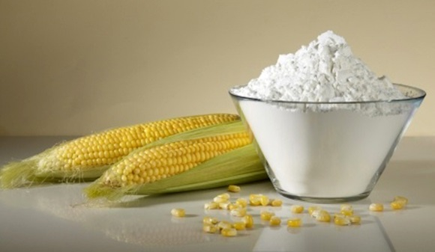
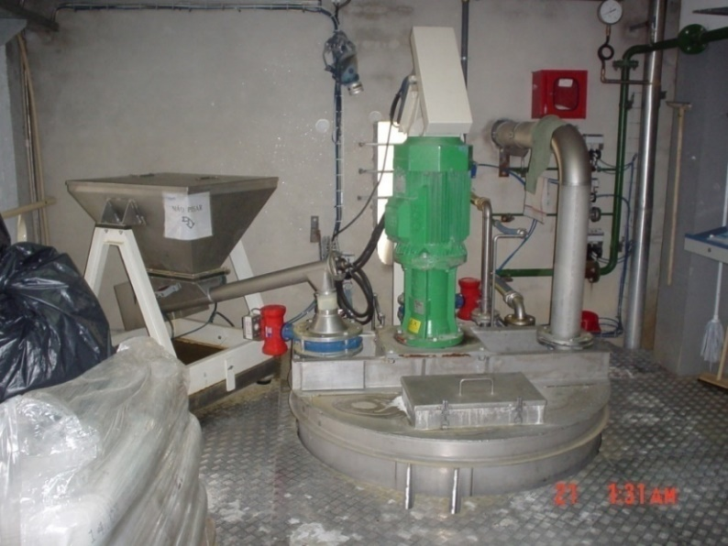
STARCH TAIL
Adhesive made with starch, water, and additives in more or less automated facilities.

Slide 13
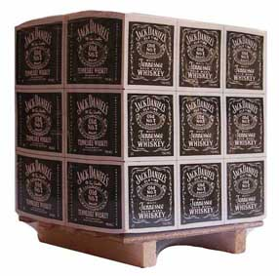
TYPES OF PAPER: LINERS OR FACES
They are the smooth outer papers and their functions are:
Provide resistance to the packaging.
Flexural stiffness
Outburst
Tear
Stacking resistance
Thanks to their ease of printing:
They provide information about packaging.
They provide information about the product.
They customize the packaging according to the customer's preferences.

Slide 14
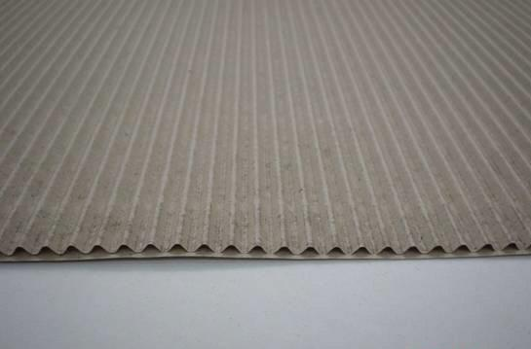
TYPES OF PAPER: MEDIUM OR FLUTING
They are the interior corrugated papers and their functions are:
Provide mechanical characteristics to the packaging:
Bending stiffness mainly
Stacking resistance
It provides cushioning capability to the packaging thanks to the elasticity provided by its waveform shape.
Give the cardboard an initial thickness or gauge.

Slide 15
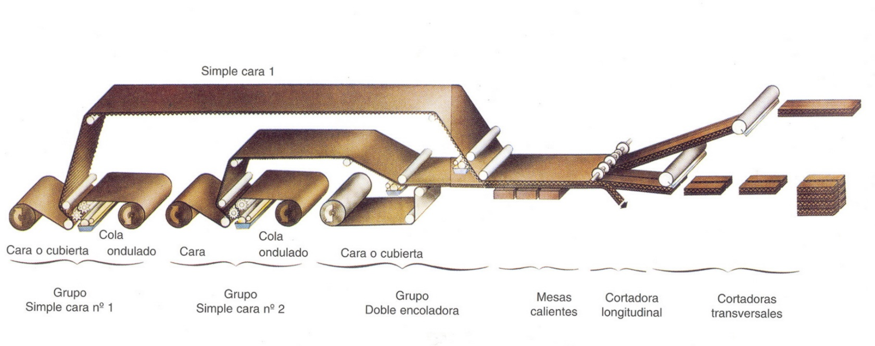
WAVE MACHINE
The corrugator is a production line, consisting of a series of machines and complementary facilities, where corrugated cardboard is manufactured from paper reels and an adhesive made with different types of starch.

Slide 16
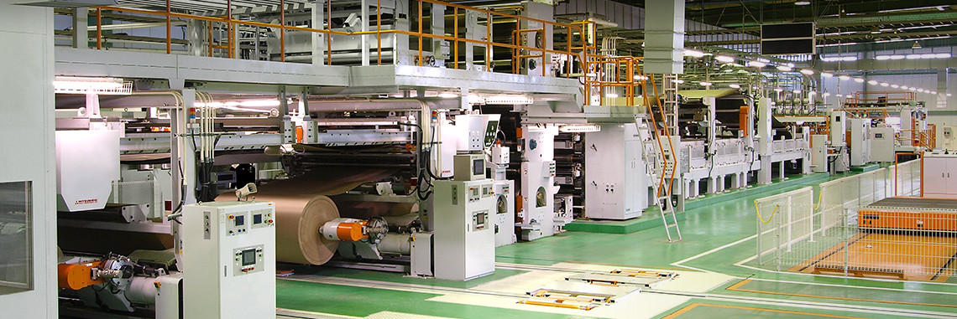
WET-END CORRUGATOR
Front part of the corrugator, where starch glue, steam, and water are used.

Slide 17
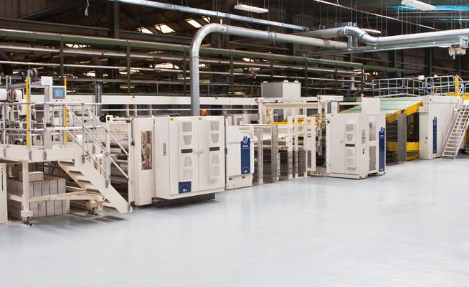
DRY WAVES - END
Final part of the corrugator, where no starch, steam, and water are applied.

Slide 18
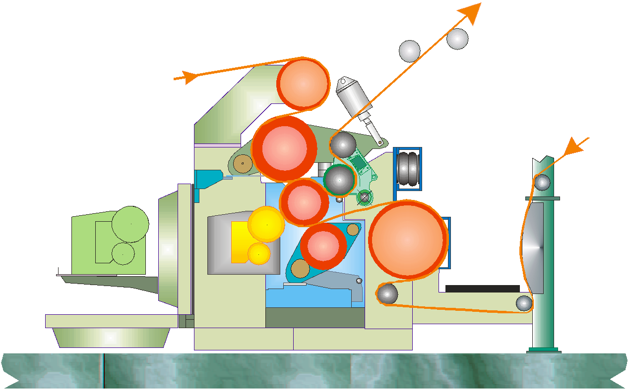
WAVE GROUP
Machines with flat press

Slide 19
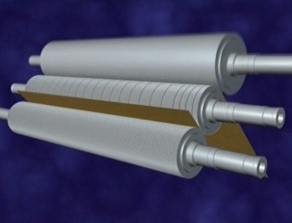
WAVE GROUP
Group with smooth press cylinder working, the pressure is around 20 N/cm.

Slide 20
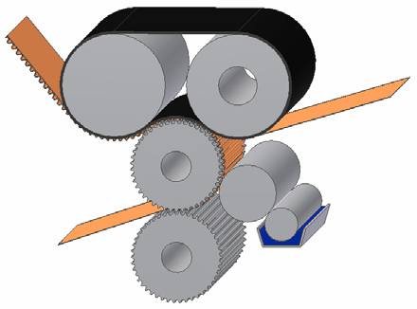
WAVE GROUP
Machines without flat press

Slide 21
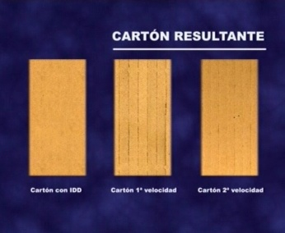
WAVE GROUP: PRESS MARKS
Machine without flat press
Machine with flat press
There are losses in the mechanical characteristics of the cardboard when working with one type of machine or another.
They can range from 5 to 10% of the value of the ECT, depending on the design and mechanical condition of the press and fluted rollers.
In perfect design and preservation conditions of the wavy group, these differences may be minor or practically nonexistent.

Slide 22
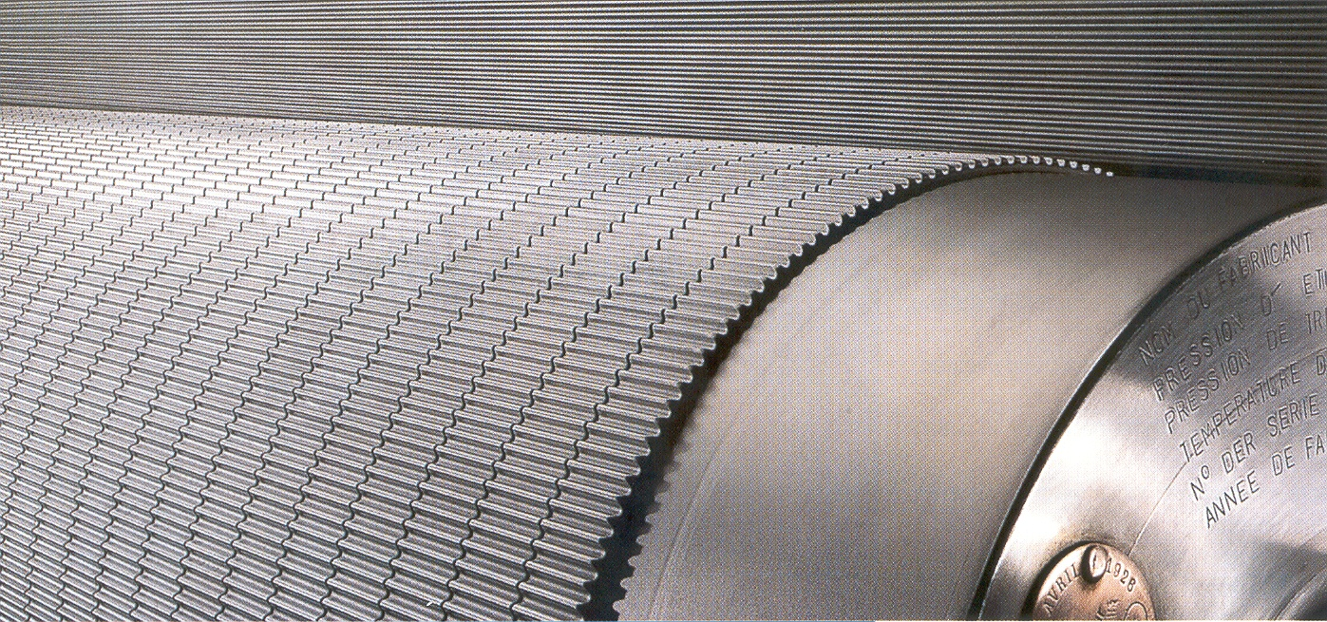
WAVE ROLLERS
The corrugating rolls are the key element of the corrugator as they define the characteristics of the cardboard, based on the use of the sine wave.

Slide 23
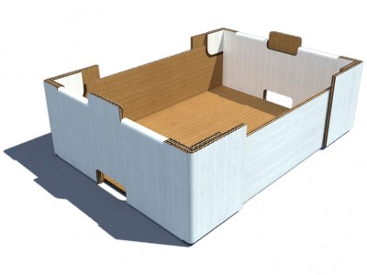
STRUCTURAL CHARACTERISTICS
The behavior of corrugated cardboard and the box, once manufactured, are directly related to the following parameters, which must be taken into account.
Weight and characteristics of the papers used
Wave class and formation
Characteristics of wavy hair types
Gauge
Stuck
Final humidity
Flatness
Superficial aspect

